Slide 1
Static Equilibrium
Dr. Jacob Moore
Associate Professor of Engineering
Penn State Mont Alto

Slide 2
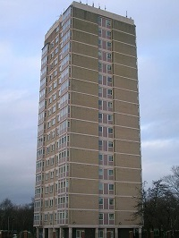
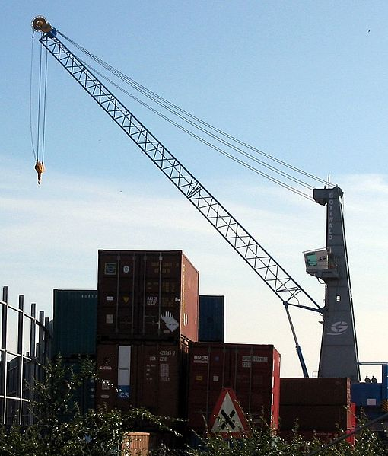
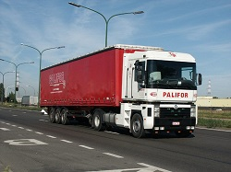
Static Equilibrium
An object that is in equilibrium is not accelerating.
Image by Tomasz Sienicki under CC-BY-SA 3.0 License

Slide 3

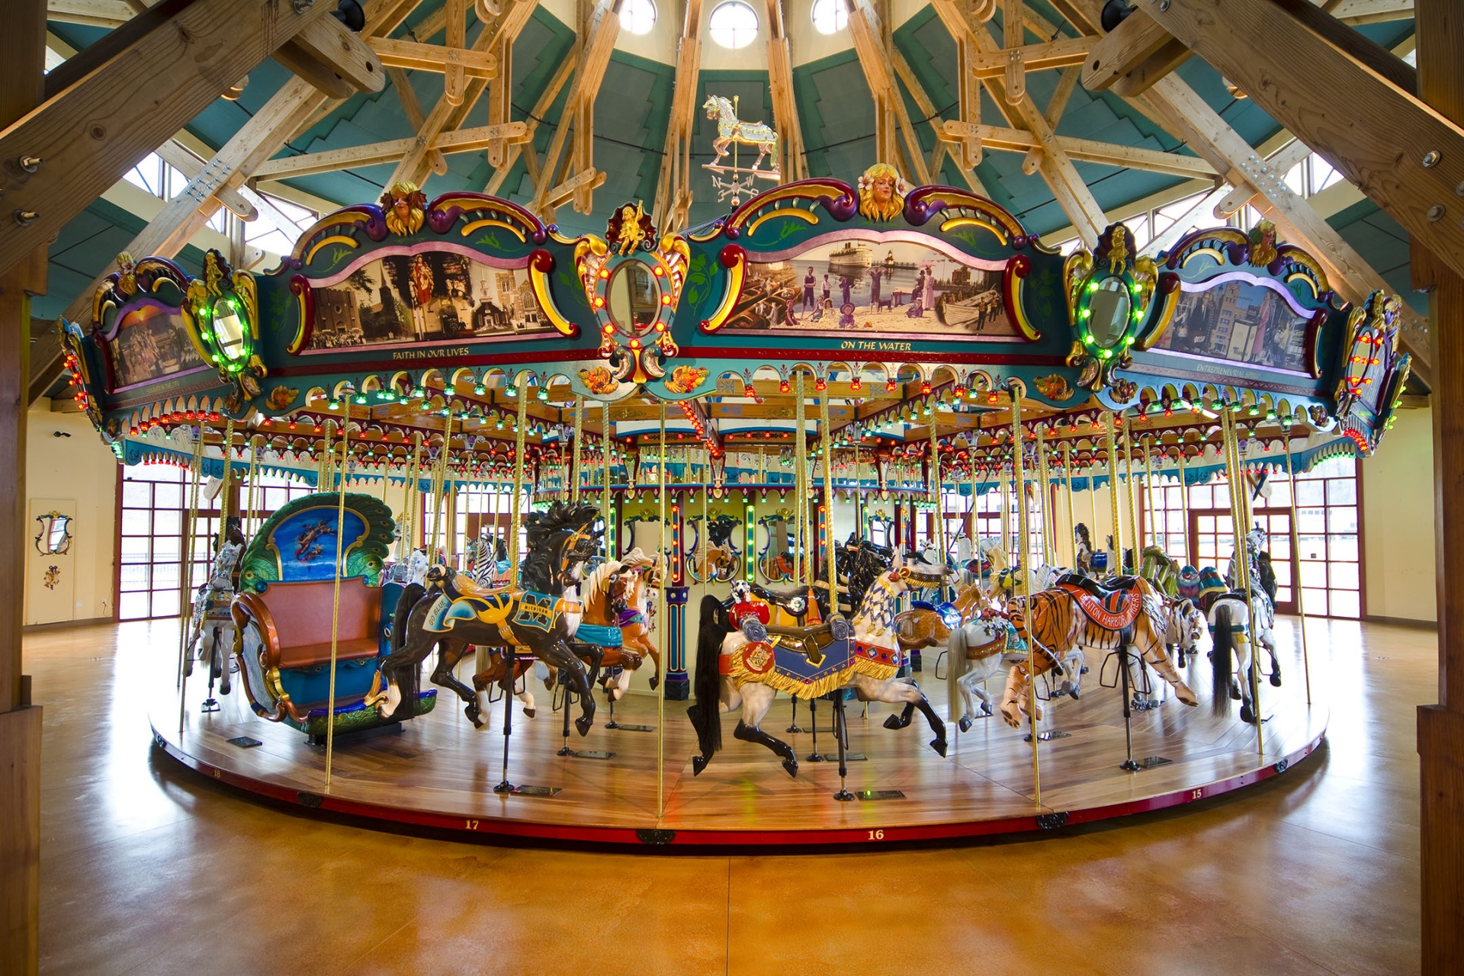
Static Equilibrium
An object is accelerating if it is changing speed or it is changing direction.
Image by Anomie under CC-BY-SA 2.0 License

Slide 4
Analyzing Bodies in Equilibrium

Slide 5
Free Body Diagram

Slide 6

The Equations of Equilibrium
Start with Newton’s Second Law
$$\vec{F} = m ∗ \vec{a}$$
If $\vec{a}$ = 0…
$$\vec{F} =0$$

Slide 7



The Equations of Equilibrium
Important details…
$$F=0$$
$$ΣF=0$$
$$Σ\overset{⃑}{F}=0$$

Slide 8
Free Body Diagram

Slide 9
Free Body Diagram

Slide 10
Free Body Diagram

Slide 11
Free Body Diagram

Slide 12
Analyzing a Body in Static Equilibrium
Use images of the problem to create the free body diagram.
Use the free body diagram to write the equilibrium equations.
Solve the equations of the equilibrium to find the magnitude and direction of unknown forces.

Slide 13
Thanks for Watching
See other engineering mechanics videos and access the full tool at…

